Slide 1
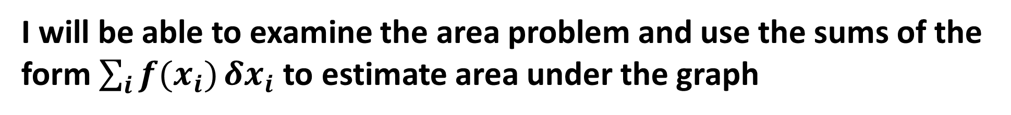
Learning Objective
I will be able to examine the area problem and use the sums of the form $\sum_{i}{f(x_{i})}δx_{i}$ to estimate area under the graph
Success Criteria
At the end of the lesson, I will be able to:
Use inscribe or circumscribe rectangles to estimate the area under the graph.

Slide 2
The Area Under a Curve
When we use the term ‘integration’ → This refers to the process of calculating the area under a curve.
We do this by cutting the region below a curve into smaller parts, such as rectangles, and so that when we sum the area of the rectangles together, we find the area under the curve.

Slide 3
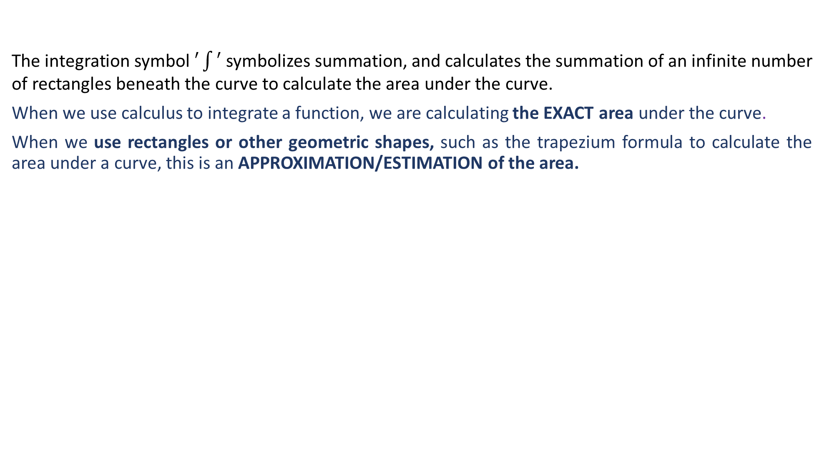
Integration as Summation
The integration symbol $′\int{′}$ symbolizes summation, and calculates the summation of an infinite number of rectangles beneath the curve to calculate the area under the curve.
When we use calculus to integrate a function, we are calculating the EXACT area under the curve.
When we use rectangles or other geometric shapes, such as the trapezium formula to calculate the area under a curve, this is an APPROXIMATION/ESTIMATION of the area.

Slide 4
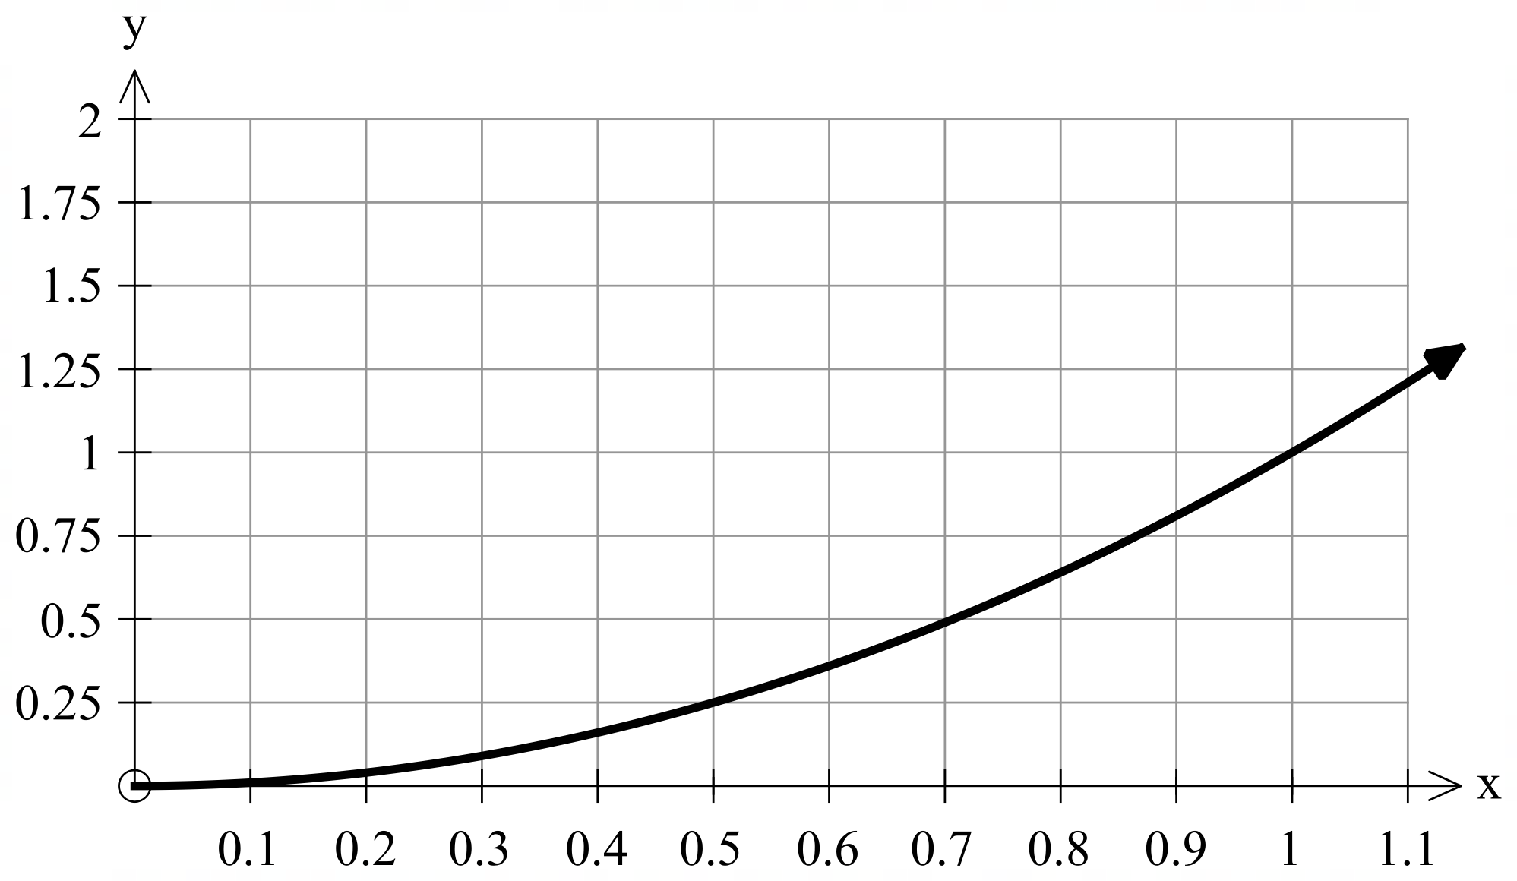

Using Rectangles to Estimate the Area Under a Curve
To estimate the area under a curve, we:
Dividing the curve into sections using rectangles,
find the area of each rectangle and add them together to find the required region.
This can be done in three ways:
Overestimation/Circumscribed Rectangles: the rectangles overlap the curve so that the area is overestimated.
Underestimation/Inscribed Rectangles: the rectangles leave a gap underneath the curve so that the area is underestimated.
Midpoint/Centred Rectangles: the middle of the top edge of the rectangle just touches the curve to form centred rectangles.
Notice that the widths of each rectangle are the same (0.1 units). The length of each rectangle is calculated by substituting the $x$-value it just touches on the curve into the function, in this case $y=x^{2}$
$$Area of each rectangle = Length×Width$$
$$Area of each rectangle =0.1x^{2}$$

Slide 5
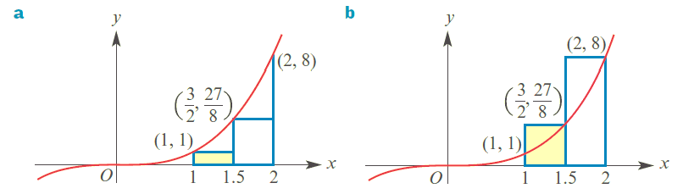





Guided Practice
Approximate the are under the curve $y=x^{3}$ between $x=1$ and $x=2$ by finding the sum of the areas of the rectangles.
Area = $\frac{1}{2}\left(1\right)+\frac{1}{2}\left(\frac{27}{8}\right)$
Area = $\frac{1}{2}\left(\frac{27}{8}\right)+\frac{1}{2}\left(8\right)$
= $\frac{35}{16} units^{2}$
= $\frac{27}{16}+4$
= $5\frac{11}{16}units^{2}$
Inscribed/underestimate
Circumscribed/overestimate

Slide 6
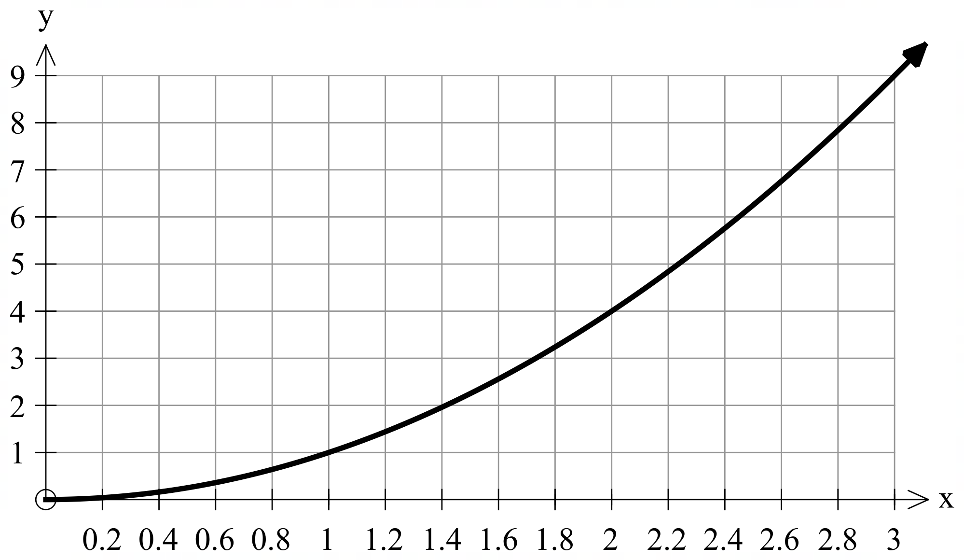

Guided Practice
Determine an approximation of the area under the curve $y=x^{2}$ for $2≤x≤3$ using inscribed and circumscribed rectangles.

Slide 7
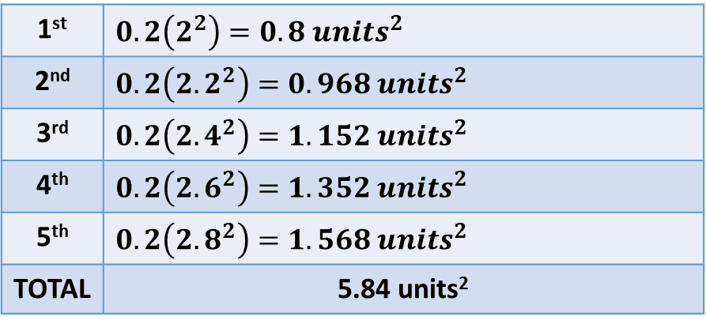
Guided Practice
Determine an approximation of the area under the curve $y=x^{2}$ for $2≤x≤3$ using inscribed and circumscribed rectangles.
REMEMBER: Underestimations or inscribed rectangles leave a gap under the curve.
1st | $$0.2\left(2^{2}\right)=0.8 units^{2}$$
2nd | $$0.2\left({2.2}^{2}\right)=0.968 units^{2}$$
3rd | $$0.2\left({2.4}^{2}\right)=1.152 units^{2}$$
4th | $$0.2\left({2.6}^{2}\right)=1.352 units^{2}$$
5th | $$0.2\left({2.8}^{2}\right)=1.568 units^{2}$$
TOTAL | 5.84 units²

Slide 8
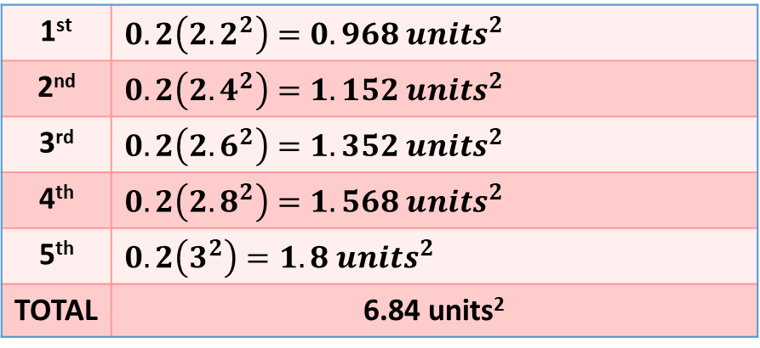
Guided Practice
Determine an approximation of the area under the curve $y=x^{2}$ for $2≤x≤3$ using inscribed and circumscribed rectangles.
REMEMBER: Overestimations or circumscribed rectangles overlap the curve.
1st | $$0.2\left({2.2}^{2}\right)=0.968 units^{2}$$
2nd | $$0.2\left({2.4}^{2}\right)=1.152 units^{2}$$
3rd | $$0.2\left({2.6}^{2}\right)=1.352 units^{2}$$
4th | $$0.2\left({2.8}^{2}\right)=1.568 units^{2}$$
5th | $$0.2\left(3^{2}\right)=1.8 units^{2}$$
TOTAL | 6.84 units²

Slide 9
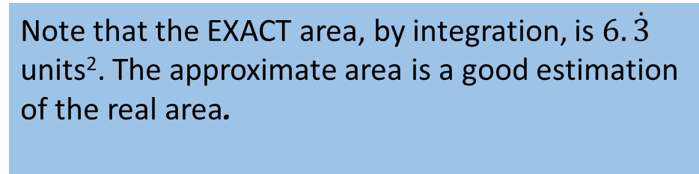
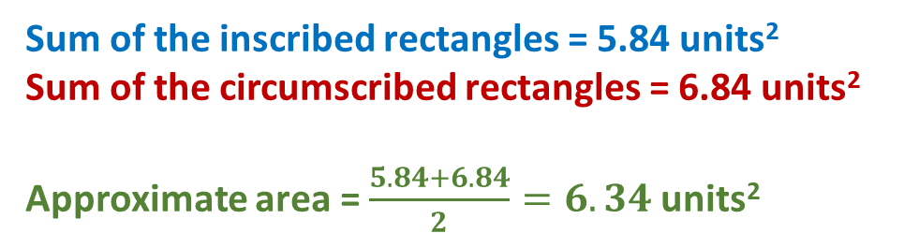
Guided Practice
Determine an approximation of the area under the curve $y=x^{2}$ for $2≤x≤3$ using inscribed and circumscribed rectangles.
Sum of the inscribed rectangles = 5.84 units²
Sum of the circumscribed rectangles = 6.84 units²
Approximate area = $\frac{5.84+6.84}{2}=6.34$units²
Note that the EXACT area, by integration, is $6.\dot{3}$
units². The approximate area is a good estimation
of the real area.

Slide 10
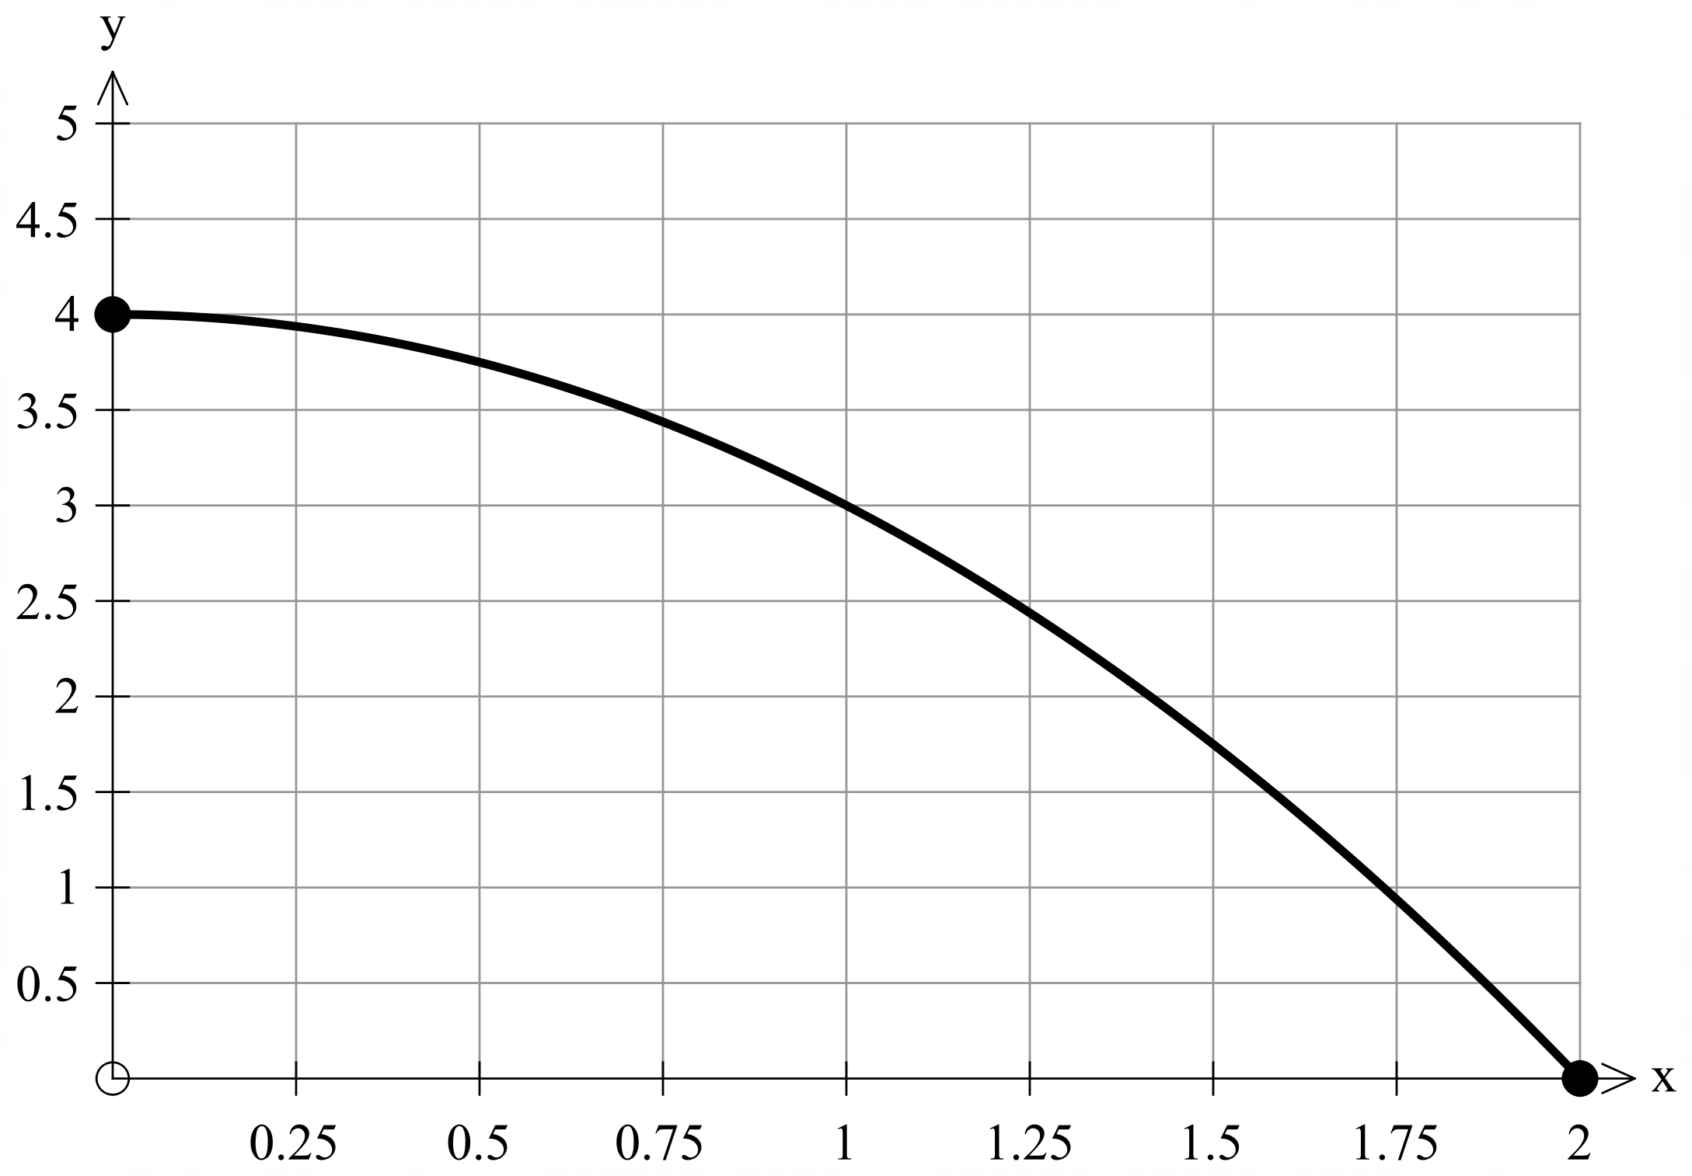

EXAMPLE2
Guided Practice
Use eight inscribed and circumscribed rectangles to calculate the approximate area under the curve $y=4−x^{2}$ from $0≤x≤2$.

Slide 11

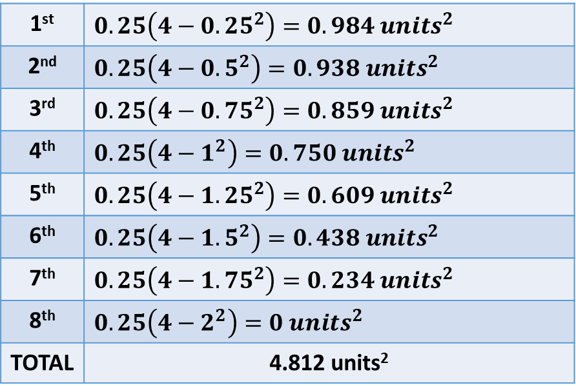
Guided Practice
Use eight inscribed and circumscribed rectangles to calculate the approximate area under the curve $y=4−x^{2}$ from $0≤x≤2$.
REMEMBER: Underestimations or inscribed rectangles leave a gap under the curve. Note you can only see 7 rectangles for the underestimation because the 8th has an area of 0 units².
1st | $$0.25\left(4−{0.25}^{2}\right)=0.984 units^{2}$$
2nd | $$0.25\left(4−{0.5}^{2}\right)=0.938 units^{2}$$
3rd | $$0.25\left(4−{0.75}^{2}\right)=0.859 units^{2}$$
4th | $$0.25\left(4−1^{2}\right)=0.750 units^{2}$$
5th | $$0.25\left(4−{1.25}^{2}\right)=0.609 units^{2}$$
6th | $$0.25\left(4−{1.5}^{2}\right)=0.438 units^{2}$$
7th | $$0.25\left(4−{1.75}^{2}\right)=0.234 units^{2}$$
8th | $$0.25\left(4−2^{2}\right)=0 units^{2}$$
TOTAL | 4.812 units²
The width of each rectangle is constant (0.25 units)

Slide 12
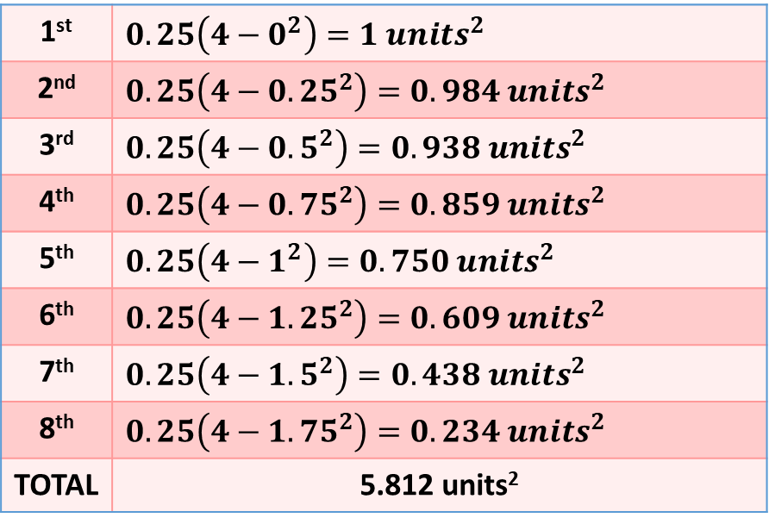
Guided Practice
Use eight inscribed and circumscribed rectangles to calculate the approximate area under the curve $y=4−x^{2}$ from $0≤x≤2$.
REMEMBER: Overestimations or circumscribed rectangles overlap the curve.
1st | $$0.25\left(4−0^{2}\right)=1 units^{2}$$
2nd | $$0.25\left(4−{0.25}^{2}\right)=0.984 units^{2}$$
3rd | $$0.25\left(4−{0.5}^{2}\right)=0.938 units^{2}$$
4th | $$0.25\left(4−{0.75}^{2}\right)=0.859 units^{2}$$
5th | $$0.25\left(4−1^{2}\right)=0.750 units^{2}$$
6th | $$0.25\left(4−{1.25}^{2}\right)=0.609 units^{2}$$
7th | $$0.25\left(4−{1.5}^{2}\right)=0.438 units^{2}$$
8th | $$0.25\left(4−{1.75}^{2}\right)=0.234 units^{2}$$
TOTAL | 5.812 units²
The width of each rectangle is constant (0.25 units)

Slide 13
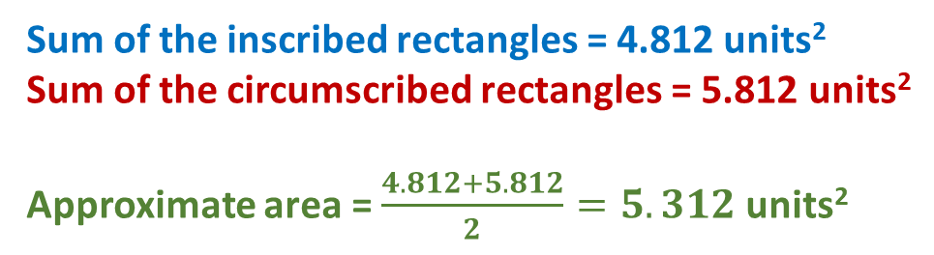

Guided Practice
Use eight inscribed and circumscribed rectangles to calculate the approximate area under the curve $y=4−x^{2}$ from $0≤x≤2$.
Sum of the inscribed rectangles = 4.812 units²
Sum of the circumscribed rectangles = 5.812 units²
Approximate area = $\frac{4.812+5.812}{2}=5.312$ units²
Note that the EXACT area, by integration, is $5.\dot{3}$
units². The approximate area is a good estimation
of the real area, but how can we make our
estimation better?
By decreasing the width of the rectangles so that we use more rectangles to estimate the area.

Slide 14
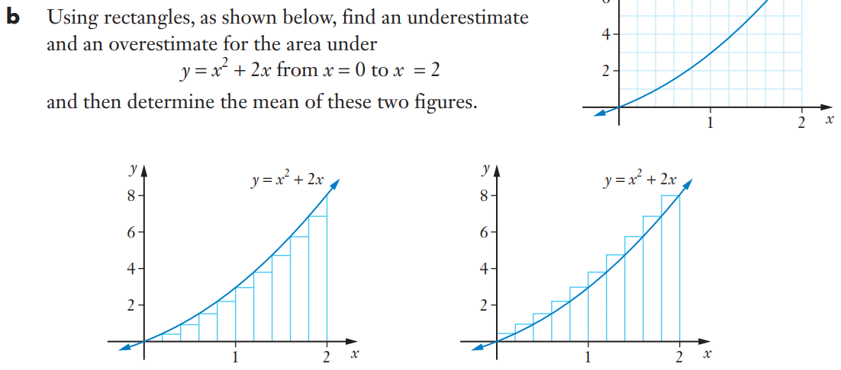
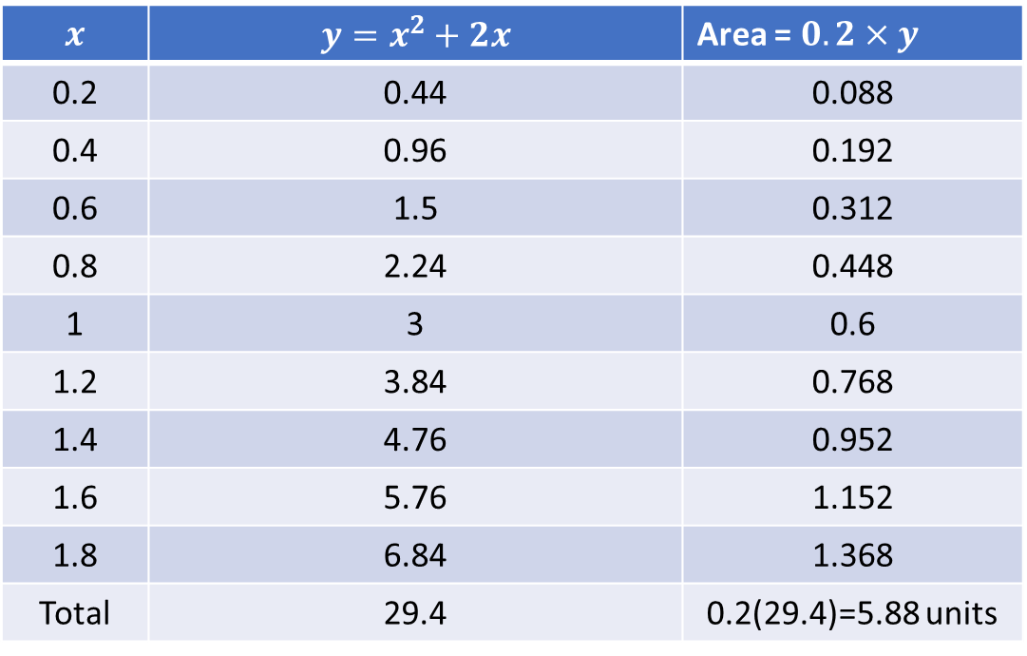
Guided Practice
$$x$$ | $$y=x^{2}+2x$$ | Area = $0.2×y$
0.2 | 0.44 | 0.088
0.4 | 0.96 | 0.192
0.6 | 1.5 | 0.312
0.8 | 2.24 | 0.448
1 | 3 | 0.6
1.2 | 3.84 | 0.768
1.4 | 4.76 | 0.952
1.6 | 5.76 | 1.152
1.8 | 6.84 | 1.368
Total | 29.4 | 0.2(29.4)=5.88 units

Slide 15
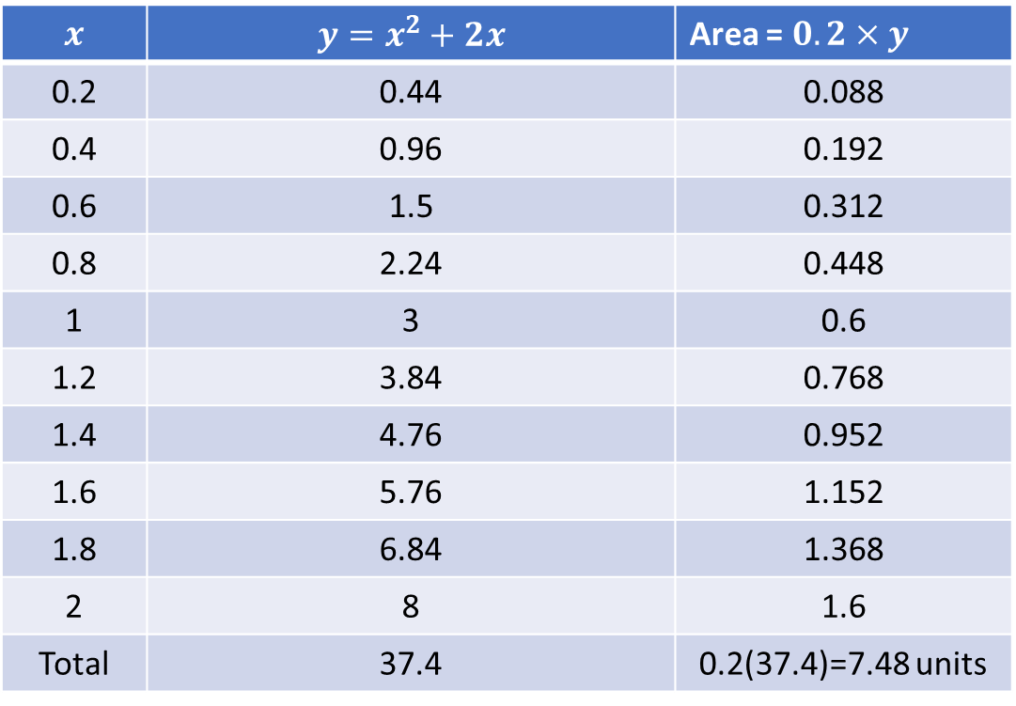
Guided Practice
$$x$$ | $$y=x^{2}+2x$$ | Area = $0.2×y$
0.2 | 0.44 | 0.088
0.4 | 0.96 | 0.192
0.6 | 1.5 | 0.312
0.8 | 2.24 | 0.448
1 | 3 | 0.6
1.2 | 3.84 | 0.768
1.4 | 4.76 | 0.952
1.6 | 5.76 | 1.152
1.8 | 6.84 | 1.368
2 | 8 | 1.6
Total | 37.4 | 0.2(37.4)=7.48 units

Slide 16
Guided Practice

Slide 17
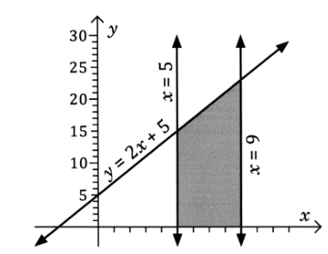
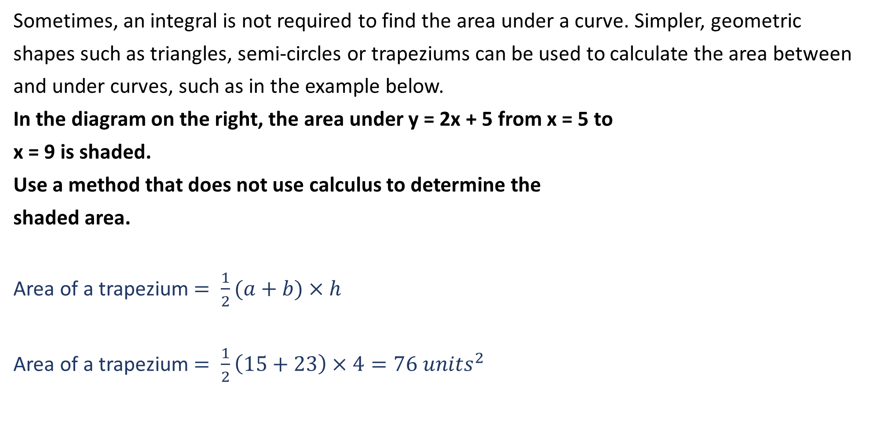
Guided Practice
Sometimes, an integral is not required to find the area under a curve. Simpler, geometric
shapes such as triangles, semi-circles or trapeziums can be used to calculate the area between
and under curves, such as in the example below.
In the diagram on the right, the area under y = 2x + 5 from x = 5 to
x = 9 is shaded.
Use a method that does not use calculus to determine the
shaded area.
Area of a trapezium $= \frac{1}{2}(a+b)×h$
Area of a trapezium $= \frac{1}{2}\left(15+23\right)×4=76 units^{2}$

Slide 18
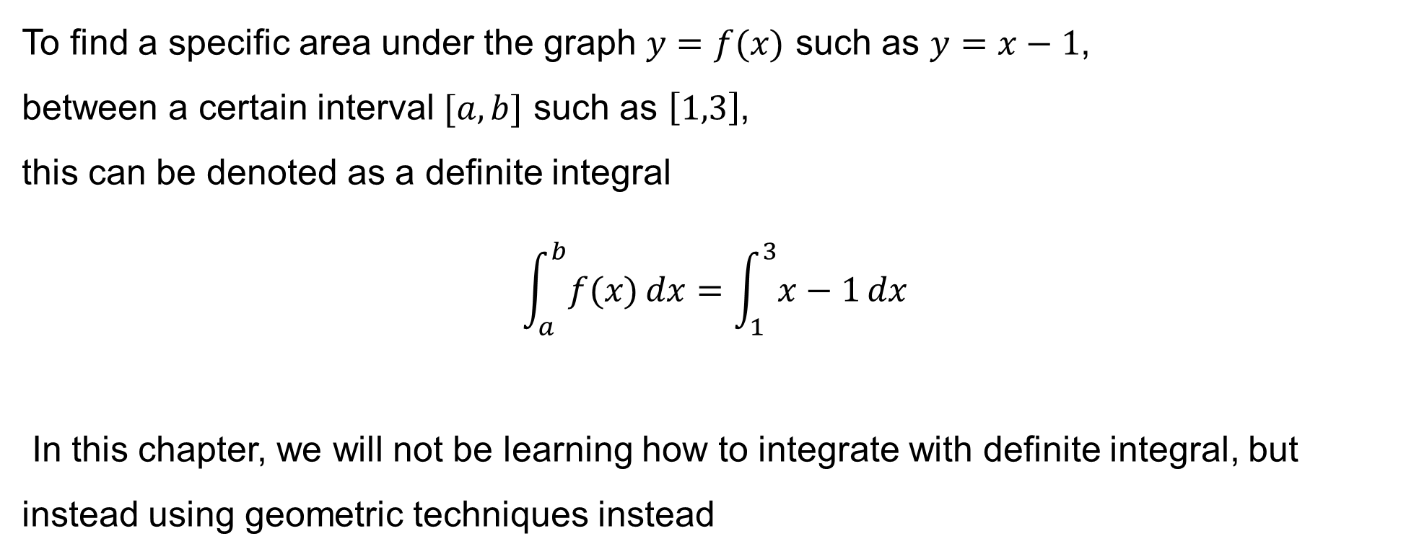
Definite Integral
To find a specific area under the graph $y=f(x)$ such as $y=x−1$,
between a certain interval $[a, b]$ such as $\left[1,3\right]$,
this can be denoted as a definite integral
$$\int_{a}^{b}{f(x)}dx=\int_{1}^{3}{x−1}dx$$
In this chapter, we will not be learning how to integrate with definite integral, but instead using geometric techniques instead

Slide 19
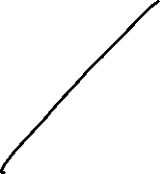
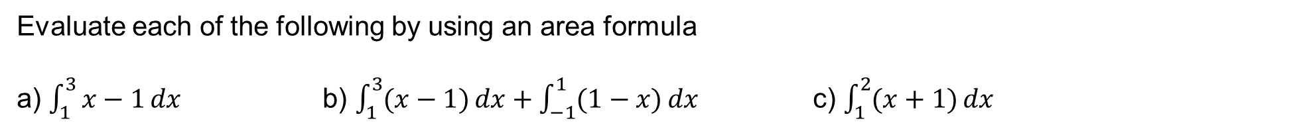
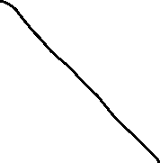
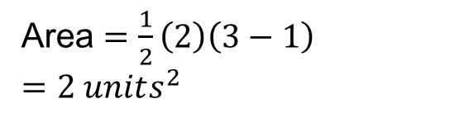
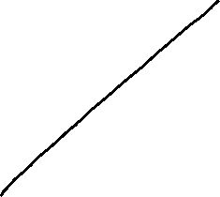

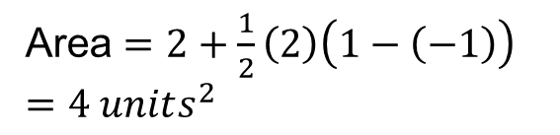
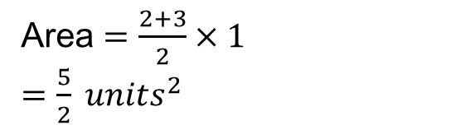
Definite Integral
Evaluate each of the following by using an area formula
a) $\int_{1}^{3}{x−1}dx$ b) $\int_{1}^{3}{(x−1)}dx+\int_{−1}^{1}{(1−x)}dx$ c) $\int_{1}^{2}{(x+1)}dx$
a)
b)
c)
Area $=\frac{1}{2}\left(2\right)\left(3−1\right)$
$=2 units^{2}$
Area $=2+\frac{1}{2}\left(2\right)\left(1−\left(−1\right)\right)$
$=4 units^{2}$
Area $=\frac{2+3}{2}×1$
$=\frac{5}{2} units^{2}$

Slide 20
Independent Practice
Complete Cambridge Ex 6A
Extra worksheet on Connect
Ignore Cambridge’s terminology of left-endpoint and right-endpoint estimate

